Slide 1
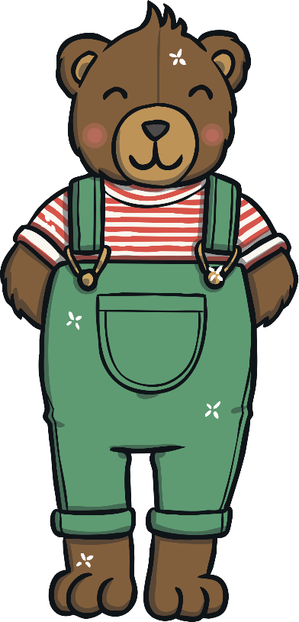
Contents
Frog Pond Subtraction
Hungry Monkey Subtraction
Popping Bubbles – Number Line Subtraction
Poor Bobby Bear – Counting Back
Colourful Flowers Subtraction
Missing Spots
Horse Jump Subtraction
Superhero Subtraction

Slide 2
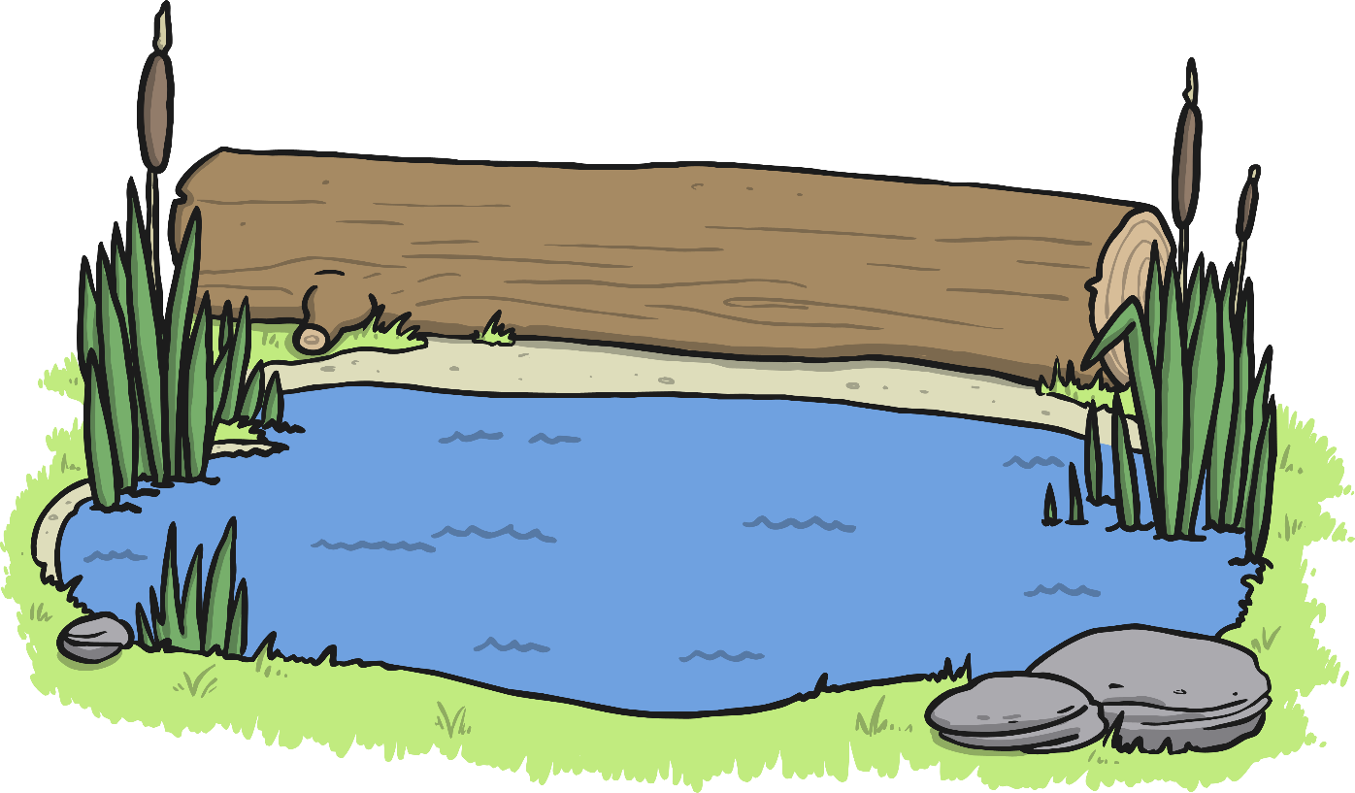
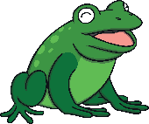
Frog Pond Subtraction
How many frogs are left on the log?
The frogs are sitting on the log. Click the frogs to make them jump into the pond.
How many frogs were on the log?
reset
click again
Click on the fish to reveal questions that encourage the development of children’s mathematical reasoning skills.

Slide 3
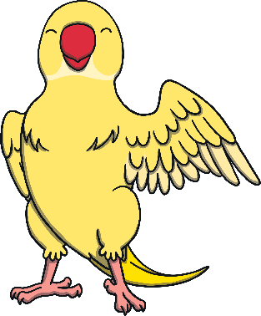
Hungry Monkey Subtraction
How many bananas
are left?
Can you help the hungry monkey eat his lunch?
How many bananas are there?
reset
click again
Click on the hungry monkey to help him eat his lunch.
Click on the Polly the parrot to reveal questions that encourage the development of children’s mathematical reasoning skills.

Slide 4
Popping Bubbles – Number Line Subtraction
If 1 bubble pops, how many would be left?
How many bubbles are there?
Darcy is having fun blowing lots of bubbles!
Can you use the number line to work out how many bubbles will be left if another bubble pops?
reset
click again
click again
Pop a bubble!
0
1
2
3
4
5
Click on Darcy to reveal questions that encourage the development of children’s mathematical reasoning skills.

Slide 5
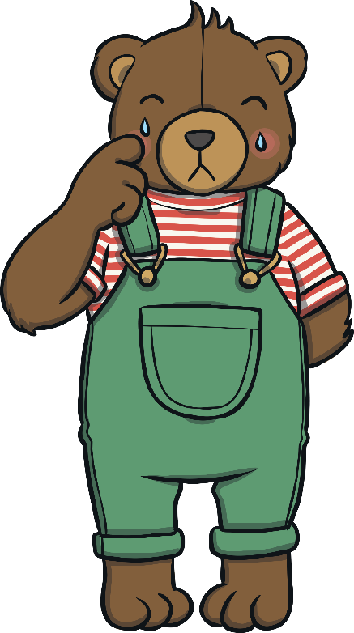
Poor Bobby Bear – Counting Back
Did Bobby’s temperature go up or down when he had the medicine?
Bobby Bear is poorly. His temperature is 7. If we give him some medicine, his temperature should go down by 3.
Can you count back 3 from 7? What will his temperature be?
reset
click again
Click on the medicine to make Bobby better.
Click on the doctor to reveal questions that encourage the development of children’s mathematical reasoning skills.

Slide 6
Colourful Flowers Subtraction
How many flowers are not yellow?
How many flowers will there be in the basket?
Bettie only wants yellow flowers in the basket. Can you say which flowers are not yellow? Click on the basket to move the flowers.
How many flowers are yellow?
reset
click again
click again
Click on Bettie to reveal questions that encourage the development of children’s mathematical reasoning skills.

Slide 7
Missing Spots
How many spots disappeared?
Can you explain what is happening to Dotty’s spots?
Dotty the dog is very spotty. How many spots does Dotty have? Each time the wind blows, a spot blows off!
How many spots does Dotty have left now?
reset
click again
click again
Lose a spot!
0
1
2
3
4
5
6
7
8
9
10
Click on the cat to reveal questions that encourage the development of children’s mathematical reasoning skills.

Slide 8
Horse Jump Subtraction
How many jumps are left when she has jumped over 2?
How many has Emma got left to jump over after she has jumped over the first one?
Emma enjoys horse riding and she loves going over the jumps! How many jumps does she have to go over?
reset
click again
Click on the horseshoe to reveal questions that encourage the development of children’s mathematical reasoning skills.

Slide 9
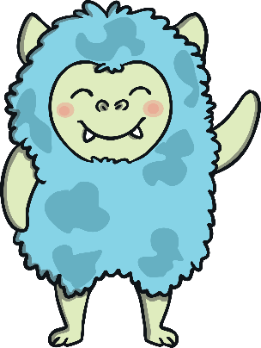
Superhero Subtraction
How many superheroes haven’t arrived on their planet yet?
How many superheroes are flying home to their planet?
The superheroes are flying through the sky. They are trying to get home to their planet.
How many superheroes have made it so far?
reset
click again
click again
Help the superheroes get home.
Click on alien to reveal questions that encourage the development of children’s mathematical reasoning skills.

