Slide 2
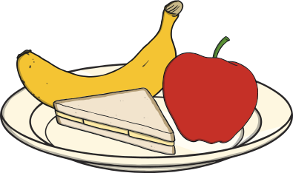
Introduction
I am Hungry Monster!
I am always hungry and I love eating lots of food.
Can you help me work out how many things are left on each plate after I have eaten some?

Slide 3
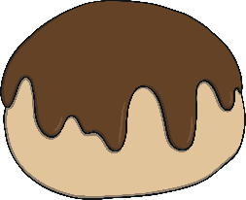
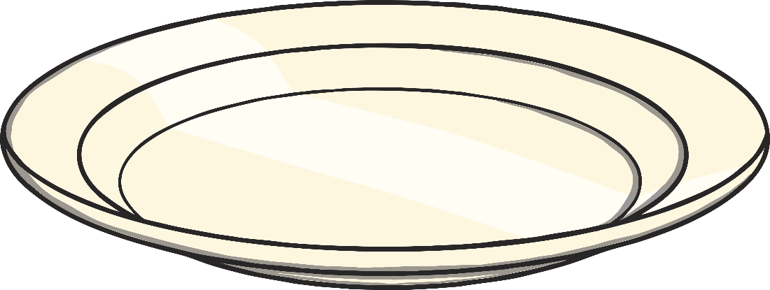
How many buns are on the plate?
Click me!
How many buns are left after Hungry Monster eats 1? Can you explain this to a friend using the number line?
Answer
0
1
2
3
4
5

Slide 4
How many apples are on the plate?
Click me!
How many apples are left after Hungry Monster eats 1? Can you check this on the number line?
Answer
0
1
2
3
4
5

Slide 5
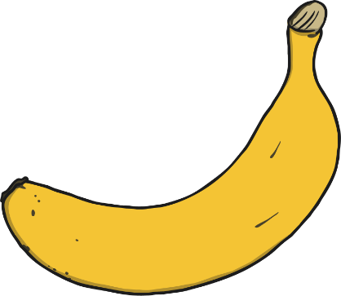
How many bananas are on the plate?
Click me!
How many bananas are left after Hungry Monster eats 1? I think there will be 1 banana left. Am I correct? Why or why not?
Answer
0
1
2
3
4
5

Slide 6
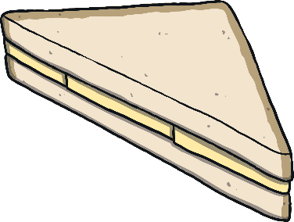
How many sandwiches are on the plate?
Click me!
How many sandwiches are left after Hungry Monster eats 1? What do you notice happening on the number line?
Answer
0
1
2
3
4
5

Slide 7
How many strawberries are on the plate?
Click me!
How many strawberries are left after Hungry Monster eats 1? Can you show a friend how to do this using your fingers?
Answer
0
1
2
3
4
5

Slide 8
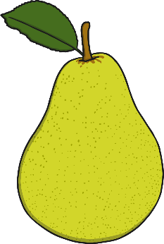
How many pears are on the plate?
Click me!
How many pears are left after Hungry Monster eats 2? Can you tell a friend about what Hungry Monster did?
Answer
0
1
2
3
4
5

Slide 9
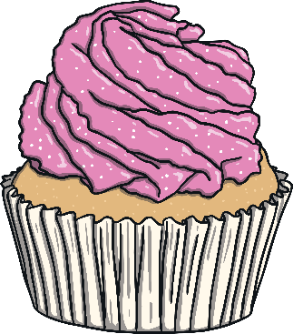
How many cakes are on the plate?
Click me!
How many cakes are left after Hungry Monster eats 2? Can you say a sentence about the cakes using the words ‘take away’?
Answer
0
1
2
3
4
5

Slide 10
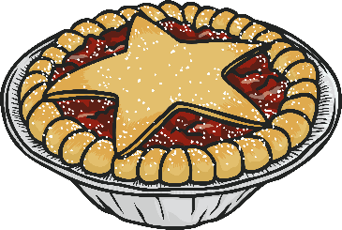
How many pies are on the plate?
Click me!
How many pies are left after Hungry Monster eats 3? When we take things away, what happens on a number line?
Answer
0
1
2
3
4
5

Slide 11
The End
Thank you for helping me to work out how much food is left for me to eat tomorrow!
Click to play again.

