Slide 2
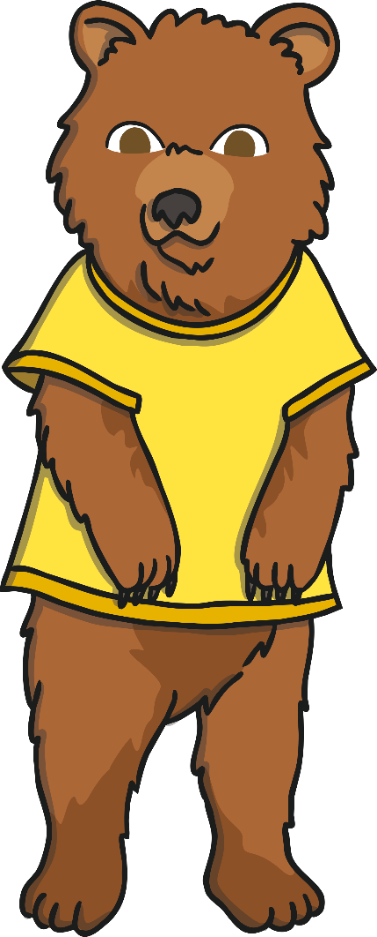
Introduction
I am having a party! Can you help me share some cakes between my party guests?
I need to share the cakes fairly so that each guest has the same number.
Let’s start!

Slide 3
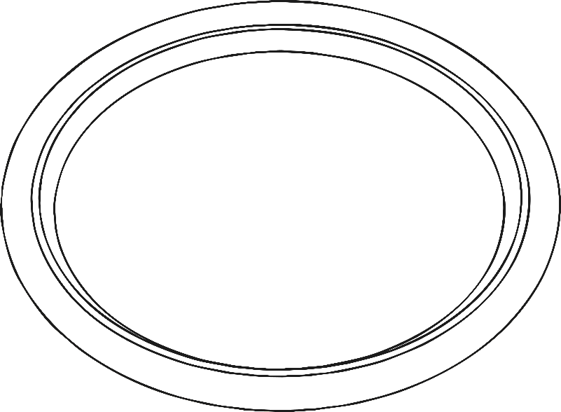
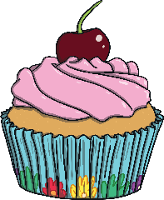
back
next
Mummy Bear has made 6 cakes. Before my guests arrive, can you help me to count them?
I have 6 cakes.
Click on the cakes to count them.

Slide 4
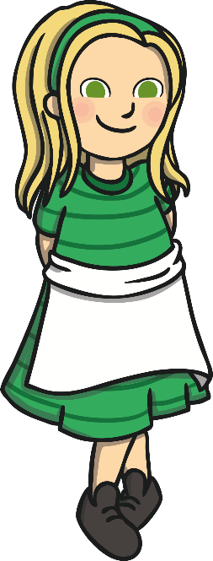
back
next
Goldilocks has arrived. Can you share the cakes equally? How many do we each get?
We have 3 cakes each.
Click on the cakes to share them.

Slide 5
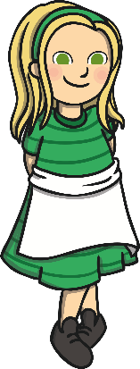
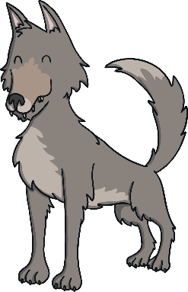
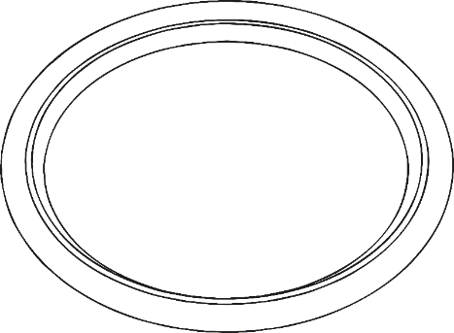
back
next
Now the Big Bad Wolf has arrived! What do you notice? Are the cakes shared fairly?
The cakes are not shared fairly.
Click on the cakes to share them.

Slide 6
back
next
Can you help me share the cakes fairly? How many cakes do we each get?
We have 2 cakes each.
Click on the cakes to share them.

Slide 7
back
next
Mummy Bear has made some more cakes. Now I have 10 cakes to share. Can you help me share them? What do you notice?
We have 3 cakes each. There is 1 cake left over.
Click on the cakes to share them.

Slide 8
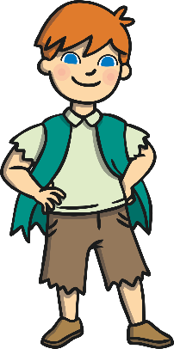
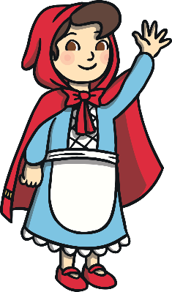
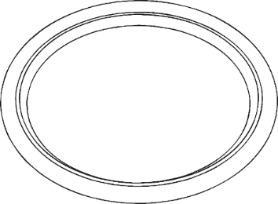
back
next
Some more guests have arrived! Click on the cakes to share them. What do you notice? Does each guest have the same number of cakes?
The cakes are not shared fairly.
Click on the cakes to share them.

Slide 9
back
next
Can you help share the cakes fairly. How many does each guest get? What is 10 shared between 5?
We have 2 cakes each.
Click on the cakes to share them.

Slide 10
The End
Thank you for helping me share the cakes fairly.
Play again!

